Slide 1
2023 Flow Manipulation Experiments
Draft 1

Slide 2

Objectives:
1. Calibrate Hydrophones – MAIN GOAL
2. Determine τ_{c}* and add data to my proposed τ_{c}* and τ* relation
3. Obtain hysteresis patterns and add to the relation between τ_{c}* and hysteresis parameter (H)
We need to simulate a 1.4 cfs event (best one so far, from summer 2021).
If we want experiment to last 10 minutes: need 2019.735 gallons in reservoirs & releasing 224.415 gpm to re-create high flow event (assuming that baseflow is 0.9 cfs currently).
MaxA
Dtmax
Requirements:
1. Working hydrophones and bedload samples
2. Working pressure transducers (divers) sampling at higher rates (not averaging every 15 mins)
3. Water samples with a high enough resolution (30-60 seconds) – Sonde data (turbidity most importantly)

Slide 3
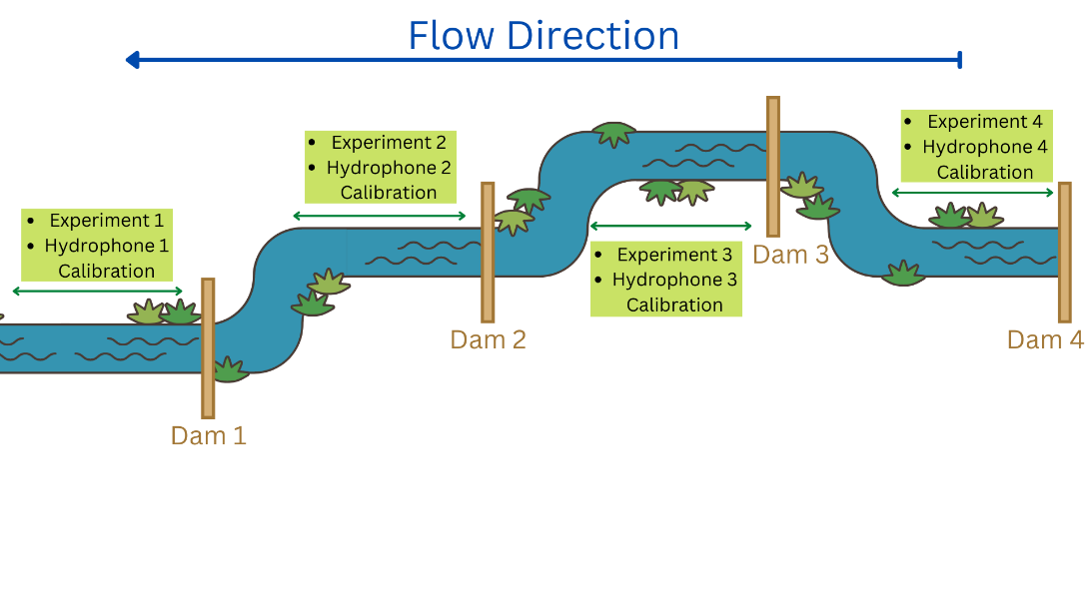
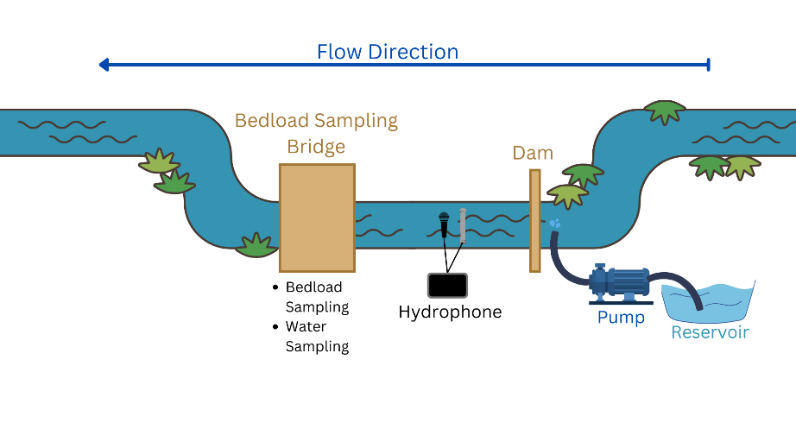
Original Plan (Proposal)
Issues with this setup:
Dams proved to be too unstable for a prolonged induced flow (they worked more as a pulse)
The pump on its own does not provide enough discharge even after the dam release
Damming and backing up the flow might affect the stream conditions upstream
Last year’s pulse experiments don’t have very great data

Slide 4
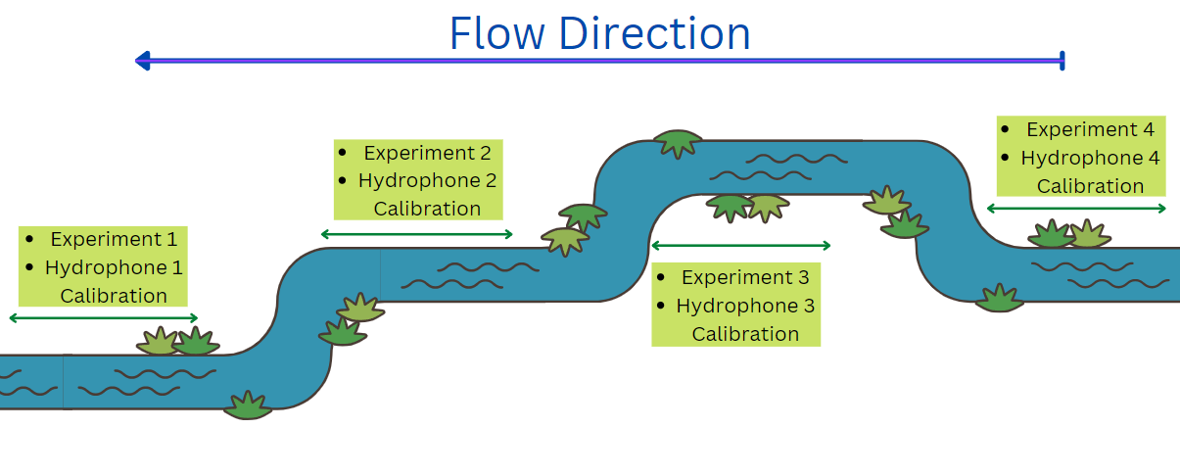
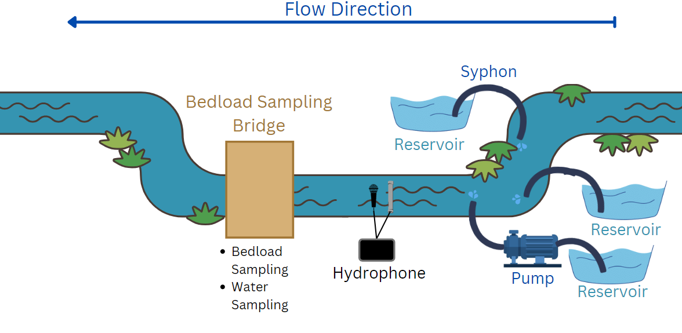
New Plan (Draft)
Changes:
No use of dams due to their unpredictability, adding the use of mega siphons to move water
Instead of one massive 2000-gallon reservoir, divide into smaller ones that work at the same time
Less invasive to upstream conditions
Potentially easier to control and might provide a better hydrograph (steadier) than the pulse experiments

Slide 5
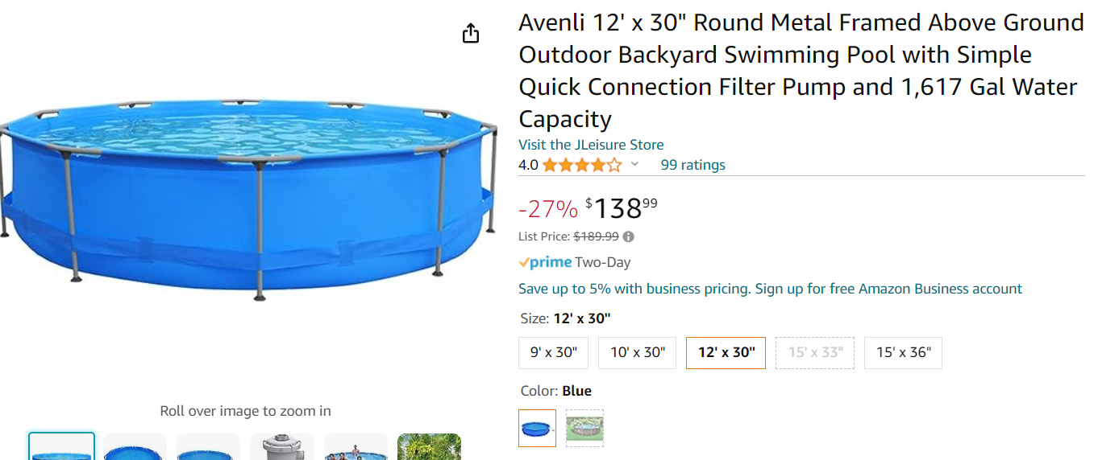
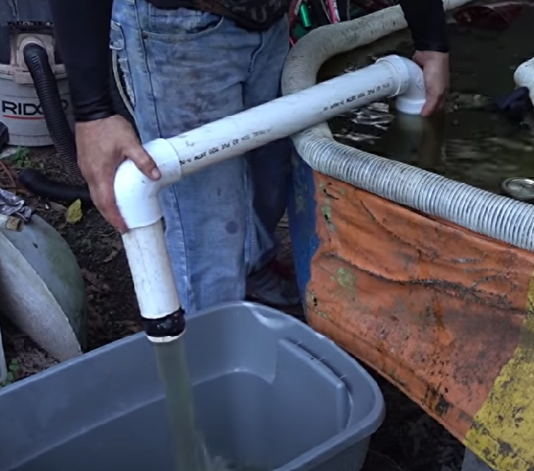
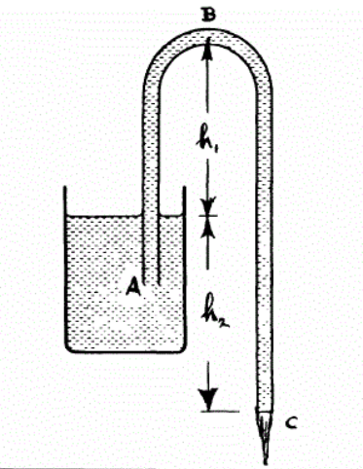
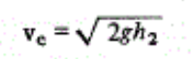
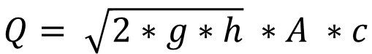
Best idea so far:
Two pools (~1000 gals each) – See example:
Filled ¾ of the way: 1200 gal each
Flow rate from siphon: 112.2 gpm (0.0071 cms)
For this we would create a mega syphon:
Using 2’’ pipe and discharge hose (5.08 cm) and Torricelli’s Law, I can obtain the required the suction head (depending on how many siphons and pools)
$$Q= \sqrt{2∗g∗h} ∗A ∗c$$
Something like this but bigger!

Slide 6





Design #1: Two pools and 4 siphons
We can play around with when we open each siphon in each pool to control the flow and give it a more “hydrograph-y” kind of shape. In this case, the design would look something like this:
S2
Assuming that the outlet of the siphon is fixed:
S1
Pool A and B dimensions:
pool_diameter = 3.048 # (m)
H = 0.762 # height of pool(m)
Siphons:
siphon_diameter = 0.0508 # (m)
initial_head_A = 0.9 # head of pool A (m)
initial_head_B = 0.9 # head of pool B (m)
Note: in my simulations 1 iteration = 10 seconds
S3
Pool A
S4
Pool B
start_time_siphon1 = 0 # Start time for the first siphon (in iterations)
start_time_siphon2 = 12 # Start time for the second siphon (in 12 iterations, i.e., 120 seconds)
start_time_siphon3 = 24
start_time_siphon4 = 36
We wait 2 mins in between releasing siphons

Slide 7
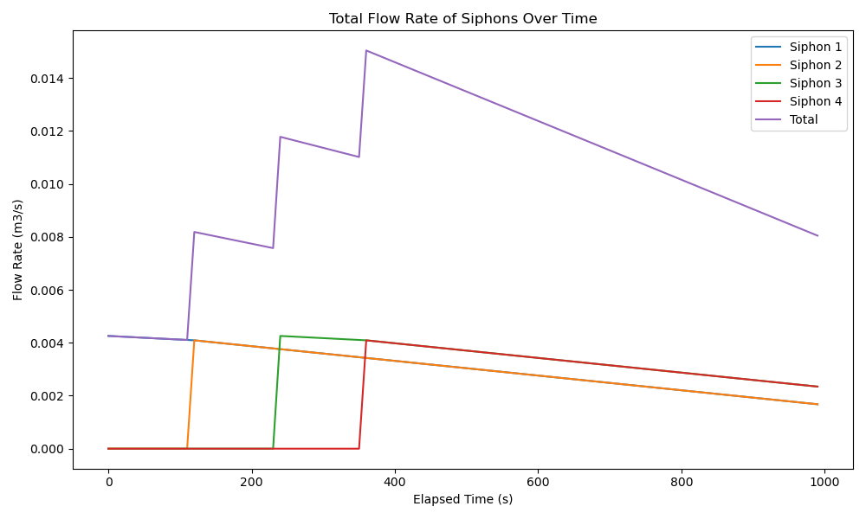
Design #1: Simulated hydrograph
Peak: 0.01504 cms

Slide 8
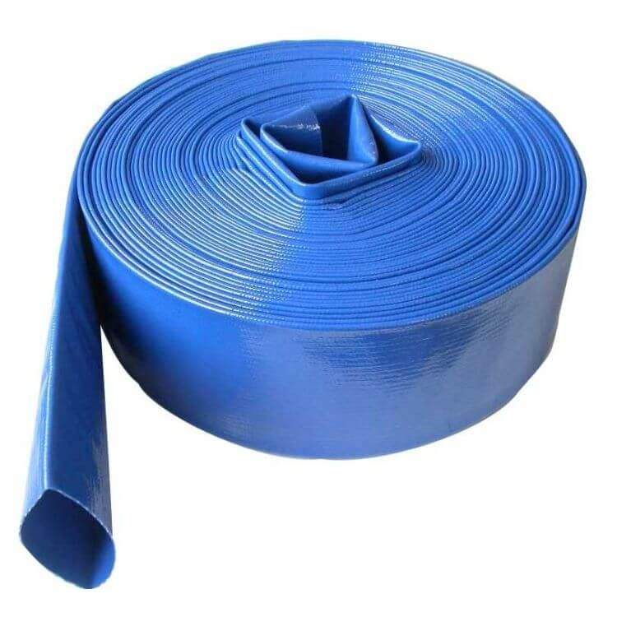
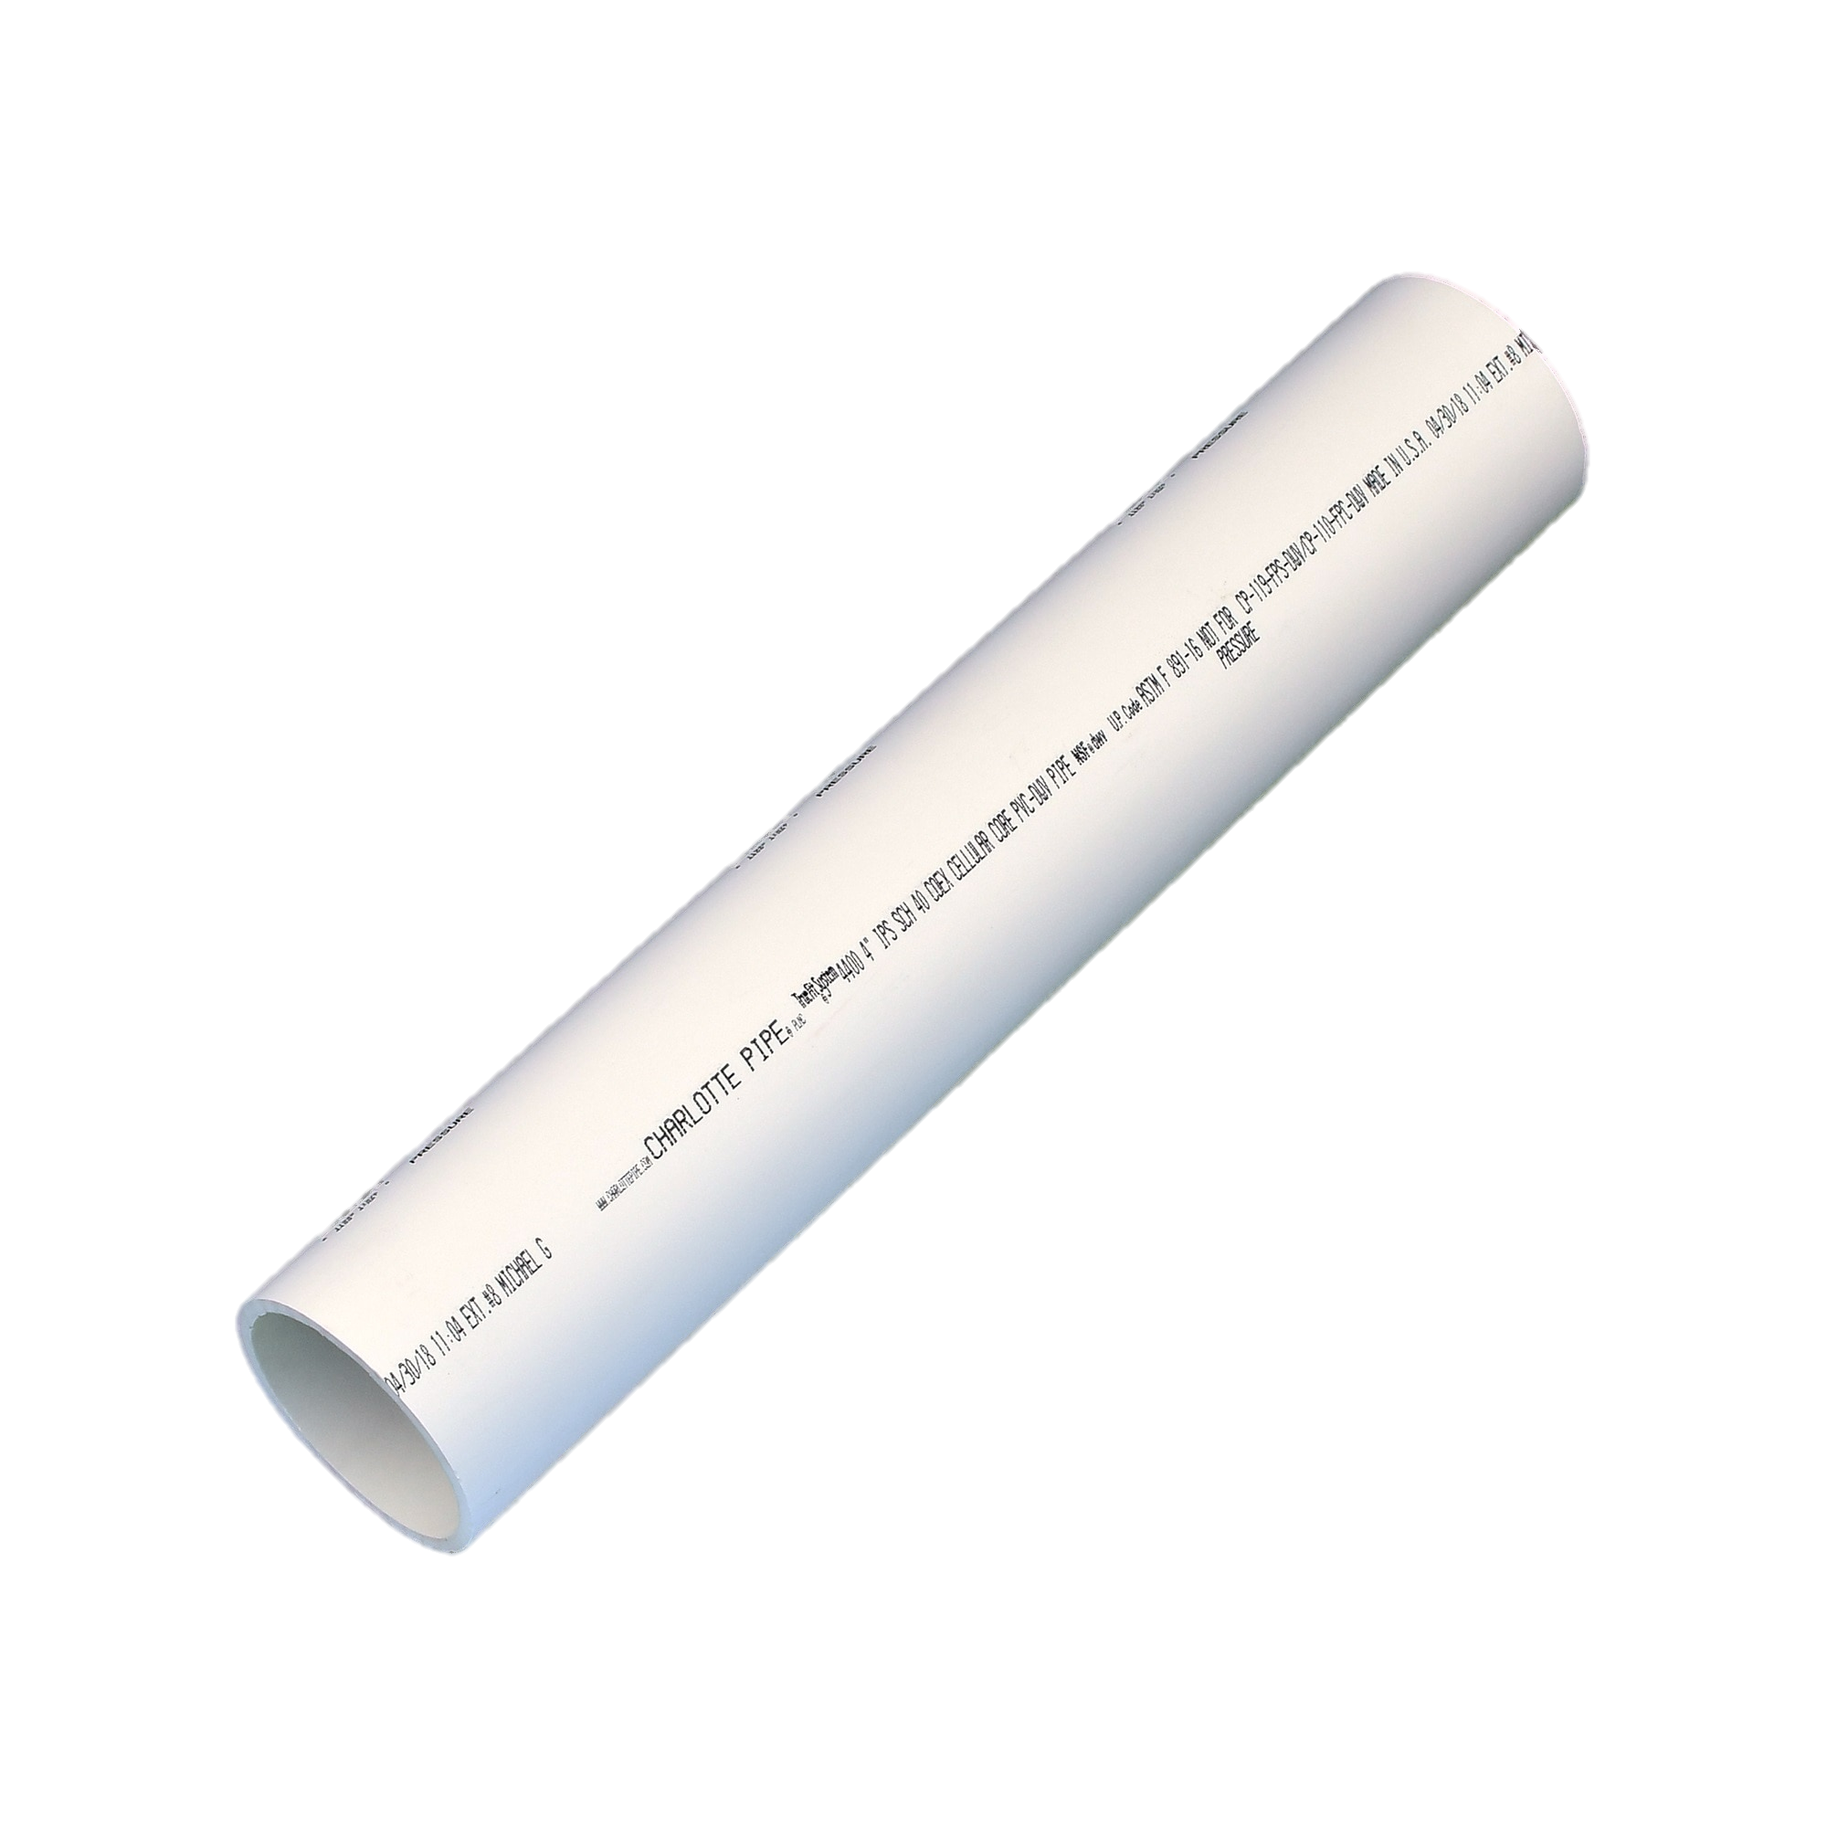
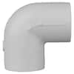
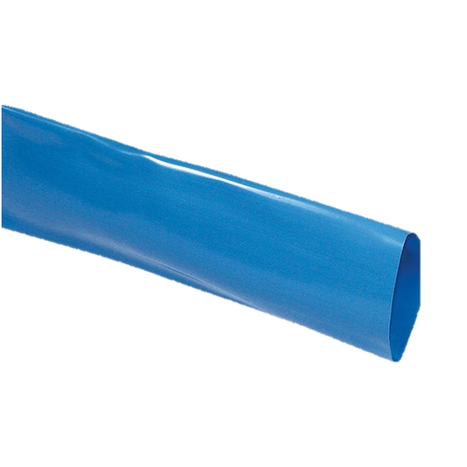
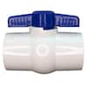
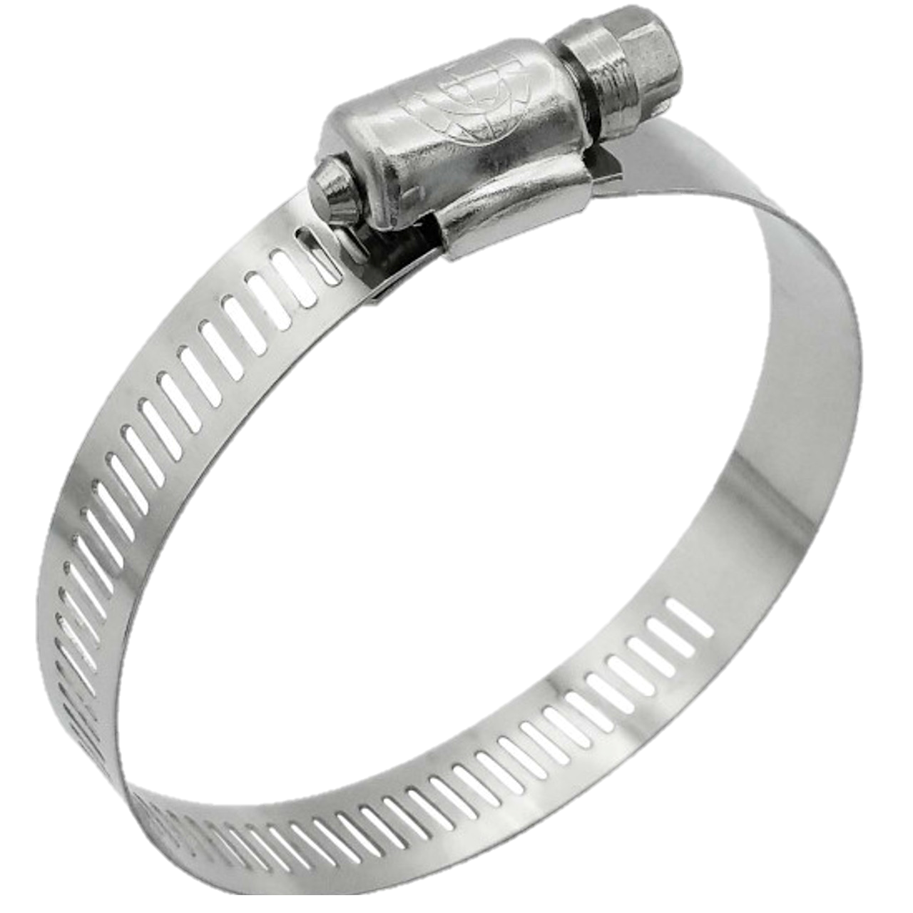
Design #1: Simulated hydrograph
How to set up? How do we control it?
1)
2)
Flat drainage hose
We only prime the PVC and seal on both sides (valve is closed) and secure
Drainage hose can be attached with a hose clamp and will allow us to reach the river and set to our desired initial head
The timing of each siphon release can be controlled by the release of the valve
Drainage hose has closed valve attached at the end of it and is primed in river
Once full of water, can be brought to reservoir and secured (we can attach small pvc pipe and hose clamp to a side of the pool perhaps?)
End of hose (where valve is) is secure in riverbed and released according to experiment design

Slide 9
Things to discuss: 1. Use of the pump besides just filling the pool? 2. BEDLOAD SAMPLING PROTOCOL FOR SUCH A SHORT AMOUNT OF TIME??? 3. Korvin’s last week here – itinerary 4. Budget? Half DOE grant half SCGSR fellowship?
Work distribution:
2 people for bedload sampling (switching samplers and dumping out sample per vertical)
0-2 people depending on sampling rate (0 if we just use ISCOs for samples and camera for timing)
2 Starting and managing the siphons, potentially the pump as well?
Will need at least 4 people in the field at all times, which I think would work out ☺

Slide 10
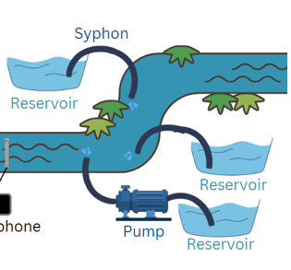
1. Use of the pump besides just filling the pool?
The design of these experiments was in case Elowyn and Andy didn’t have enough space to bring the pump and gave us more options regarding their travel (driving vs flying, etc.)
We could also do this design as one of the floods, and then do a second higher one WITH the pump (will need additional pool), since we wanted to do replicate floods anyway!
Can be discarded if too complicated?

Slide 11















2. BEDLOAD SAMPLING PROTOCOL
How many verticals?
Due to how narrow the stream is, I propose 2 equally spaced verticals in the given cross section. The time the sampler is left on the bottom should be equal to all verticals in the cross-section, so for the sake of our experiments, I suggest doing 1min per vertical and switching in between bedload samplers.
This way we are maximizing our time in the bed in order to obtain a representative bedload sample, but also ensuring that the sampler doesn’t fill 40% with sediment!!
V1
V2
Person 2: putting sample from V2 into a bucket and preparing sampler for V1 next interval
Person 1: bedload sampling V1

Slide 12
3. Korvin’s itinerary and given tasks:
Monday 7th | Tuesday 8th | Wednesday 9th | Thursday 10th | Friday 11th
Finishing triangulation for all tracer particle survey Help in lab preparing last year’s POC samples Making plots of the data Joel sent us? | Purchase and fill sandbags (in morning) WSE survey Last tracer particle survey (should be the same as the one we did two months ago) ADV measurements Grab samples | *Expected arrival of our pool* Fill more sandbags and take to field Setup pool at experimental reach (downstream) Find efficient way to fill it (using upstream water and drainage hose) | Fill more sandbags and take to field (will most likely take us three days due to how small our car is) Repeat tasks from Wednesday, but potentially make first siphon design and test in field Sort equipment to leave here and to take back to Boise | He decided to leave on Friday so we can’t really do anything

Slide 13
4. Budget? Half DOE grant half SCGSR fellowship?
How much can I spend as a max in materials with DOE grant?
Since Korvin will be gone, I will save have one month worth of rent saved up which can be spent on materials as well ☺ (Will need to pay for Alfonso’s when he gets here though)

